Slide 1

MG future structure
Structure of each department

Slide 2
Index
Topic Page Number
Overview of process flow 3
Front office functions 4-7
Middle office functions 8-10
Back office functions 11
RAC functions 12
Global finance functions 13
Other functions 14
Process flows for each location 15- 20
Organization charts 21-26

Slide 3
Overview of Process flow
Front
Middle
Back
Support services
Trading
Coordination/ Settlements
Financial ops
Credit
Authorizing new counterparties, calculating credit risk
Physical & financial
Logistic & trading support (all documentation with the exception of confirmations)
Financial reporting, management reporting, budgeting
Risk Control
Logistics
Confirmations & contracts
“Police” - analyzing P&L, reviewing violations
Shipping and secondary services
Cash mgmt
Executing contracts & confirms
Cash movements
RM/ Trade accounting
Legal
Calcs books, responsible for commercial accounts
Tax
Transaction support

Slide 4
Duties of Commercial Functions - the Front Office
Business Head Duties
Setting & Communicating strategic direction
Allocating overall trading limits
Ensuring that new types of business / significant transactions have all appropriate sign-offs
Designated Heads
Copper concentrates - Phil Bacon, NY
Metals - Michael Farmer, London, (Primary Aluminum - Sam Hainsworth, London)
Scrap - Achim Lindhorst - Germany
Broker - Craig Young, NY

Slide 5
Duties of Commercial Functions - the Front Office
swilson5:
Double check note at side with RAC.
Trading
Head trader only - Allocating limit given by business head to subordinate traders
Head trader only - Agreeing & signing daily profit reports
Managing customer relationship
Originating new business
Negotiating structured deals with counterparties
Notifying credit of any new counterparties before transaction is done
Managing risk positions of the firm (physical & financial)
Taking proprietary positions where appropriate
Negotiating trades with counterparties
Writing deal tickets
Signing of amendments made to deal tickets by commercial support
Reviewing contracts as being in accordance with the deal concluded
Keeping positions within authorised limits
Looking at credit headroom before dealing
Providing explanations for limit violation reports and signing them
Setting of pricing inputs ("curves")
Negotiating concerning mismatches of actual deliveries
Settling disputes with counterparties
Notifying Credit & Documentation of any new counterparties not already notified by Origination
Using appropriate legal entity for each trade (as determined by legal & tax depts)
Approving invoices and supporting evidence for payment for primary product
Designated Head Trading Personnel
Copper concentrates - Phil Bacon, NY
Metals - Michael Farmer, London (Primary aluminum - Sam Hainsworth, London)
Scrap - Joe Robertson, NY
Broker - T.J. Pimpinelli, NY
Note: The head trader can further allocate trading responsibility to other traders within their group. Therefore not all personnel trading need to be on the authorized trading list.

Slide 6
Duties of Commercial Functions - the Front Office
Agency
Managing customer relationship
Originating new business
Negotiating trades & structured deals with counterparties
Commiting the company to trades & ancillary services within the band set daily by the head trader
Hedging physical trades using COMEX or LME exchange instruments (not required)
Writing deal tickets
Signing of amendments made to deal tickets by commercial support
Negotiating concerning mismatches of actual deliveries
Settling disputes with counterparties
Using appropriate legal entity for each trade (as determined by the head trader)
Approving invoices and supporting evidence for payment for primary product
Designated Agency Heads (where necessary)
Copper concs - NA
Metals (including all financial positions for the scrap business)
  Copper - Joe Robertson
  Zinc - Joe Robertson
  Lead - Joe Robertson
Primary aluminum - Jean Michaud
Copper scrap - Mike Casey/Joe Robertson (NY)
Aluminum scrap - David Rosenblum/Joe Robertson (NY)
Broker (proprietary positions) - Michael Hutchinson
Broker (US) - NA
swilson5:
Note: With Jean Michaud being the prime alu agency head, will David/Bob report to him for this?

Slide 7
Duties of Commercial Functions - the Front Office
Logistics
Locating transport/transmission opportunities / booking berths
Negotiating contracts for secondary services
Recording terms of contracts for services
Recording terms of amendments of contracts for services
Negotiating with suppliers of secondary services concerning actual outruns
Reviewing and amending contracts from a logistics standpoint
Scheduling movements
Monitoring journeys
Calculating loading volumes
Directing sample taking
Monitoring quality reports / reviewing inspectors reports
Providing documentation for customs
Monitoring completeness of shipments for loading & discharge as recorded by coordination
Calculating, monitoring and negotiating demurrage
Notifying risk management of demurrage payable and receivable and any other agreements
Approving invoices with supporting evidence for payment for secondary services
Placement of Logistics
Copper concs - Dan Murphy, NY
Metals - Janet Vala-Terry, NY (all primary aluminum -Nicole Dion, Montreal)
Copper scrap - Ruth Zarren-Koch, St. Louis
Aluminum scrap - Derik Van Deusen, Chicago
Broker - NA

Slide 8
Duties of Commercial Support - the Middle Office
Co-ordination & Settlements
Primary responsibilities: Logistic & trading support, liasion with cash mgmt dept (all documentation with the exception of confirmations)
Updating logistics system for delivery information
Reconciling logistic (volume, delivery and location) systems to external statements
Reconciling delivery reports to positions from risk management systems
Preparing supporting evidence for payment of invoices for both primary product and secondary services & sending out these statements
Confirming (either in writing or verbally) incoming and outgoing payments before the statement is sent out.
Obtaining approval of payments for invoices from commercial
liasing with cash management - approving invoice for their payment
Chasing debtors for payment
Producing a weekly report of unpriced volumes (this should be done by global counterparties - is this possible for metals)
Booking the inventory into accounts and validating monthly balance
Checking of incoming invoices to delivery documents
Reconciling statements from brokersto RM system
Reconciling OTC brokerage charges from broker to accounting system
Co-ordination & Settlements (continued)
Sending negotiable documents to purchasers
Applying cash received to accounts receivable accounts on a daily basis
Monitoring accounts receivable & accounts payable
Communication overdue Accounts Receivable to account coordinators (also within this group) daily and advising of chasing required
Monitoring accounts payable balances
Raising disputes on settlement amounts to the attention of Trading
Preparing cash forcasting for next 30 days
reconciling liquidated position to risk management information
Placement of Coordination
Copper concs - NY
Metals - London
Copper scrap - NY
Aluminum scrap - NY
Broker - NA (functions needed within this dept to be combined with other two middle office departments)

Slide 9
Duties of Commercial Support - the Middle Office
Confirmations & Contracts (Documentation)
Executing contracts & confirms, liasing with “global counterparties Enron personnel”
Reviewing deal from deal ticket prepared by trading/agency and input into the risk management system by risk management/trade accounting
Reviewing amendments to trades into the risk management system
Producing confirmations &/or contracts from the deal ticket
Monitoring approvals for prepared confirmation/ contracts from traders, agency, logistics, legal, credit and tax.
Dispatching contracts to counterparties
Keeping a log of executed contracts and following up on contracts not returned, reporting this log to reporting group)
Reconciling broker confirmations to Risk Management Systems
Responding to counterparty contacts, taking advice from Legal, Credit and Logistics
Answering queries relating to contracts
Advising & following up with legal on general terms and conditions amendment requests from counterparties
Documentation (continued)
Preparing New Counterparty information for distribution and system update in response to requests from Origination & Trading
Ensuring global counterparties updates their systems for new counterparties
Producing monthly statistics concerning contracts (with the exception of executed info as this comes from global counterparties)
Liasing with the global counterparties personnel re executed confirmations
Placement of Documentation
Copper concs - NY
Metals - London
Copper scrap - NY
Aluminum scrap - NY
Broker - NY
Broker proprietary - London

Slide 10
Duties of Commercial Support - the Middle Office
Risk Management & Trade Accounting
Responsible for completing deal capture, book calcs, commercial accounts, and payment approval from an accounting standpoint
Capturing deal from deal ticket prepared by trading/agency into the risk management system
Capturing amendments to trades into the risk management system
Following up with the confirms/ contracts group on unclear positions
Obtaining sign-offs from traders on amendments made to deal tickets
Entering accruals and actuals for secondary services payable & receivable, including demurrage, into the risk management systems
Producing daily position reports
Producing & officializing daily profit reports
Verifying price inputs ("curves")
Ensuring actual prices in systems are accurate
Making trading & business head aware of violations
Communicating violations & their explanations to RAC & DPR group
Running reports of internal deals with group entities for traders to authorise (could be captured in trader sign off of all deals – don’t need to pull out)
Providing advice to business head on the risk aspects of new / proposed trades / products re how they will affect the daily positions
Approving each payment made from an accounting standpoint
Justification & analysis of monthly trading results
Risk Management & Trade Accounting (continued)
Reviewing all new trades to ensure that they are within the mandate of the business
Advising risk control of new types of trades and likely impact on suitability of existing limits
Implementing policies for income recognition for management & consolidation accounting purposes
Keeping commercial accounts in general ledger accurate and reconciled
Reconciling risk management and logistics systems
Preparing booking for mark to market
Ensure adequate allocation of trading prepayments & accruals
Reconciliation of volumes traded to amounts booked
Placement of Risk Management & Trade Accounting
Copper concs - NY
Metals - London
Copper scrap - NY
Aluminum scrap - NY
Broker - NY

Slide 11
Duties of Commercial Support - the Back office
Financial Operations
Responsible to ensure proper ledgers, statutory and compliance reporting, budgeting, and reporting to the consolidation group
Non commercial AP & expenses (including batch payments)
Procurements & ordering
G&A journal entries (eg payroll), & non trading prepayments/accruals
Loan & interest calculation & posting
Allocations – calculation & posting
Fixed assets & depreciation
Ensure the validity of the whole TB for each ledger (ledger owners)
Tax liaison
Cost centre, WBS, internal order and profit centre set up & maintenance
Timesheet management
Preparation of monthly management accounts for cost centre & profit centre owners
Reconciling the monthly management accounts to the GL
Reconcile GL to DPR
Preparation of annual and quarterly forecasts
Preparation of cashflow forecasts
Analysis of budget/actual & comments to group & management
Financial Operations
Consolidating accounting information across different businesses
Reporting monthly management accounting information
Reporting information to Corporate Reporting to enable production of group statutory accounts
Producing and filing statutory accounts
Ensuring that all accounting complies with FAS and other relevant standards
Calculating and booking differences in management and consolidation income recognition (calculation may have to be done by RM) – EITF 98-10, FAS 133, intercompany profits, portfolio gross ups
Booking structured transactions
Issuing other local compliance reports
Coordinating with external auditors/handling external audit requests
Placement of Financial Operations
Copper concs - NY
Metals - London
Copper scrap - NY
Aluminum scrap - NY
Broker - NY
Broker proprietary - London

Slide 12
Duties of Commercial Support - RAC
swilson5:
RAC must provide guidance for placement of RAC
Credit
Approving new counterparties
Setting credit limits for each counterparty
Creating new counterparties in Credit Systems
Reviewing and amending contracts from a credit standpoint
Aggregating all exposures to counterparties
Monitoring compliance with credit limits
Reporting violations of credit limits to Chief Risk officer and to business head
Calculating potential credit exposure and including it in the credit exposure report
Monitoring compliance with potential exposure limits
Reporting violations of potential exposure limits to Chief Risk officer and to business head
Confirming that a given payment will or will not result in a breach of credit limit in response to a query from the coordination / settlements department
Approving each payment made from a credit standpoint
Alerting business head and Risk control when credit limits are exceeded Sending purchase confirmations to counterparties banks
Risk Control
Advising board of Directors of appropriate limits to set
Communicating limits set by Board of Directors
Indicating understanding of reasons for breaching of any limits by signing limit violation reports
Monitoring of positions and losses against limits
Obtaining signature on limit violation reports from trading
Consolidating position reports across different business – London/ Houston
Producing limit violation reports - Houston
Placement of RAC - Credit
Copper concs - NY (person to be hired for credit NY)
Metals - London
Copper scrap - NY
Aluminum scrap - NY
Broker - London
Placement of RAC - Risk Control
Copper concs - NY?/London?
Metals - London
Copper scrap - NY?/London?
Aluminum scrap - NY?/London?
Broker - NY?/London?

Slide 13
Duties of Commercial Support - Global Finance
Funding
Manage Enron Credit rating
Provide funding for all business requirements
Cash Management
Effecting manual payments to counterparties
Authorising batches of automatic payments
Liaising with banks & providing appropriate documentation (LC’s etc)
Placement of Funding
All - Houston
Placement of Cash Management
Copper concs - Houston
Metals - Houston & London
Copper scrap - Houston
Aluminum scrap - Houston
Broker - Houston & London

Slide 14
Duties of Commercial Support - Other
Tax
Authorising VAT amounts payable
Advising on optimum legal entity for booking of each type of trade
Reviewing tax clauses in contracts
Calculation of deferred tax
Preparation of tax returns
Tax advisory on structured transactions
Global counterparties
Responsible for updating and warehousing masterdata
Responsible for warehousing executed confirmations & updating statistics concerning executed contracts
Accounting advisory on structured transactions
Updating Risk Management systems for new counterparties
Transaction Support
Setting policies on income recognition
Accounting advisory on structured transactions
Legal
Writing standard contracts
Advising on transactions
Dealing with litigation
Placement of Tax
All - Joint between Houston and London
Placement of Global Counterparties
Copper concs - London
Metals - London
Copper scrap -London
Aluminum scrap - London
Broker - London?
Placement of Transaction Support
All - Houston
Placement of Legal
All - New York (someone to be hired)

Slide 15
Process flow - Copper Concentrates - NY
Breakdown positions, input into RM system, calculate MTM
Write deal ticket
RM/trade accounting
Trader
Perform secondary services
Capture secondary service movements in system, invoicing
Cash Management
Coordination/ Settlements
Logistics
Prepare confirm/contract, execute
Credit
Documentation
Legal
Legend
Houston
New York Trading
New York Middle office

Slide 16
Process flow - Metals - NY
Breakdown positions, input into RM system,
Write deal ticket
RM/trade accounting
Trader
Calculate MTM
Perform secondary services
RM/trade accounting
Logistics
Capture secondary service movements in system, invoicing
Cash Management
Coordination/ Settlements
Prepare
confirm &
execute
Prepare contract & execute
Legal
Credit
Legal
Documentation
Documentation
Legend
Houston
New York Trading
New York middle office
London middle office

Slide 17
Process flow - Broker - NY
swilson5:
Do we need any mtm calcs as all back to back?
Input into RM system, calculate MTM
Write deal ticket
RM/trade accounting
Trader
Margin calls, invoicing
Cash Management
Coordination/ Settlements
Prepare confirm/contract, execute
Credit
Credit
Documentation
Legal
Legend
Houston
New York Trading
New York Middle office
London office

Slide 18
Process flow - Broker Proprietary - NY
Input into RM system
Write deal ticket
RM/trade accounting
Trader
Calculate MTM
RM/trade accounting
Margin calls, invoicing
Cash Management
Coordination/ Settlements
Prepare confirm/contract, execute
Credit
Documentation
Legal
Legend
Houston
New York Trading
New York Middle office
London middle office

Slide 19
Process flow - Scrap - St. Louis, Chicago
Breakdown positions, input into RM system, calculate MTM
Price set within a band
Write deal ticket
RM/trade accounting
Trader
Marketers
Capture secondary service movements in system, invoicing
Perform secondary services
Coordination/ Settlements
Logistics
Prepare confirm/contract, execute
Cash Management
Credit
Documentation
Legal
Legend
Houston
New York
Chicago or Montreal
London middle office

Slide 20
Process flow - Primary Aluminum - Chicago, Montreal
Breakdown positions, input into RM system, calculate MTM
Price set within a band
Write deal ticket
RM/trade accounting
Trader
Marketers
Capture secondary service movements in system, invoicing
Perform secondary services
Coordination/ Settlements
Logistics
Prepare confirm/contract, execute
Cash Management
Credit
Documentation
Legal
Legal
Legend
Houston
London
Marketing office
New York

Slide 21
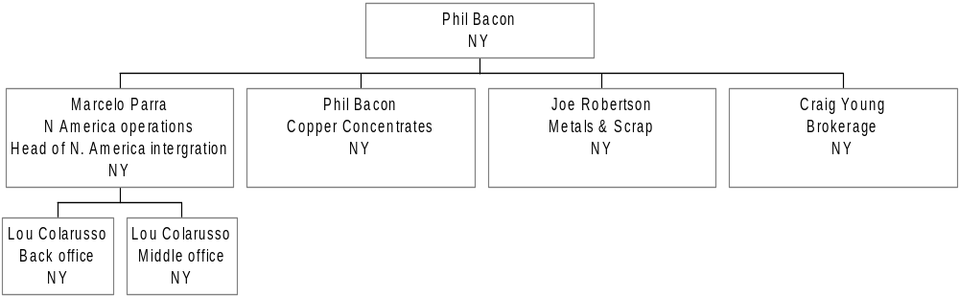
Overview of New York Office
Tom McKeever

Slide 22
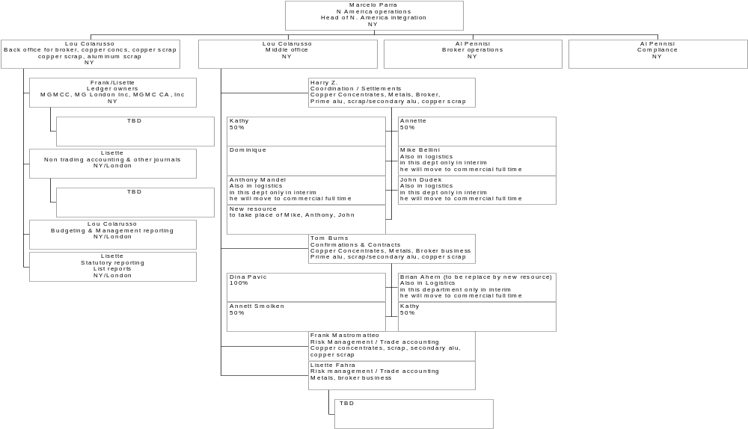
Reporting Lines for Support
swilson5:
Broker bus not done - Al is doing

Slide 23
Reporting Lines for Copper Concentrates
Mike Farmer
Phil Bacon
Copper Concentrates
NY
Spiro Spirakus
Trader
NY
Claus Pramer
Trader
NY
Patricia B
LME execution/logistics
NY
Dan Murphy
Shipping & Logistics
NY
Brian Ahern*
Logistics
NY
1 Person
Logistics
NY
Michael Bellini*
Logistics
NY
Anthony Mandel*
Logistics
NY
John Dudek*
Logistics
NY
* These people may, on occasion, perform certain trading functions

Slide 24
Reporting Lines for Scrap Business
Achim Lindhorst
Metals & Scrap
Business Head
Germany
Joe Robertson
Metals & Scrap
Trading
New York
David Rosenblum
Alu Scrap Trader
Chicago
Mike Casey
Copper Scrap Trader
St. Louis
Bob Uxa
Alu Scrap Trader
Chicago
Randy Logan
Copper Scrap
St. Louis
Derik Van-Deusen
Alu Scrap Logistics*
Chicago
Ruth Zarren-Koch
Logistics Assistant
St. Louis
Stephanie
Assistant
Chicago
Rita Maria Burkett
Logistics
Chicago
Jennifer Cornfield
Logistics
Chicago
* This person may, on occasion, perform certain trading functions

Slide 25
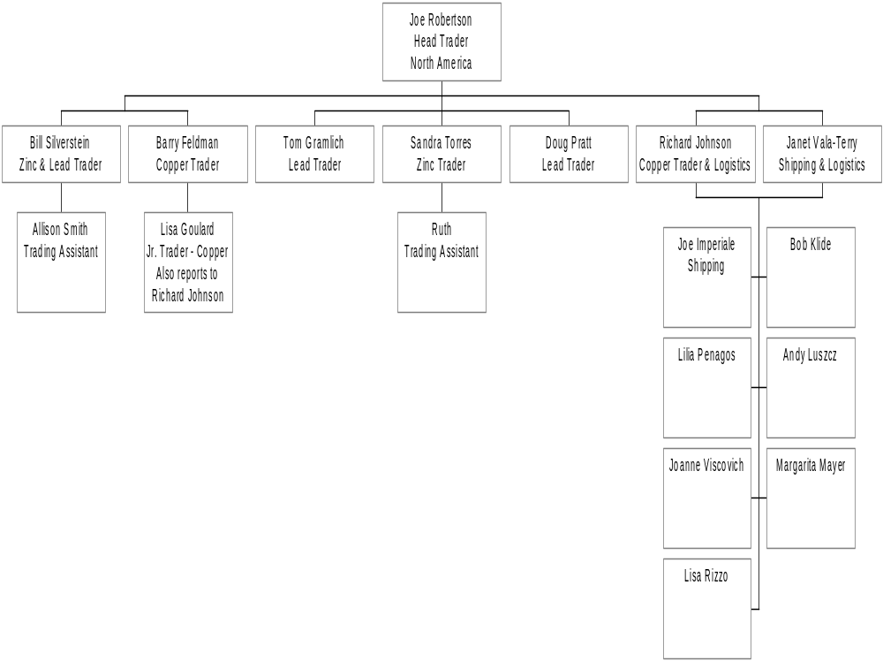
Reporting Lines for Metals Business
Mike Farmer

Slide 26
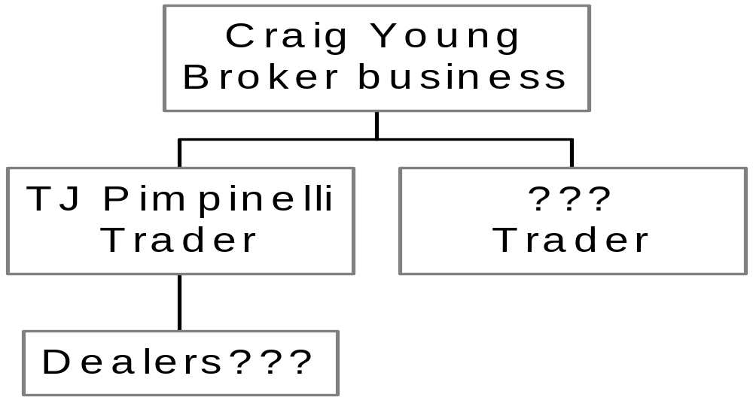
Reporting Lines for the Broker Business
swilson5:
Not done
Mike Hutchinson

Slide 27
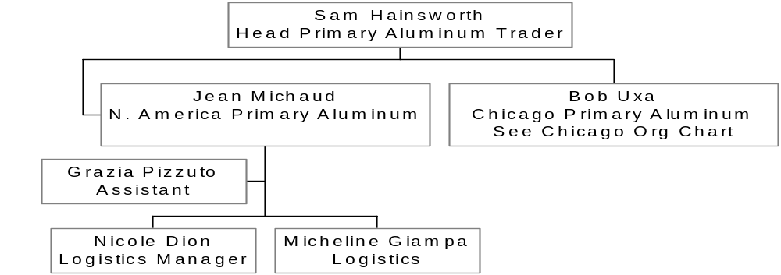
Reporting Lines for Montreal
swilson5:
Not done - get names as well as determine if Bob will report to Jean

